Slide 1

Create Your First Autocad Plugin
Ben Rand
ben@leadensky.com

Slide 2

About me
Using AutoCAD since Release 12
Learned to program using LISP in AutoCAD
Worked up from VBA to VB6 to VB.NET
Now primarily C# (occasionally still in AutoCAD!)
Worked in the Industrial Engineering field for more than 18 years as a CAD Manager, developer and IT Director
2013 Top DAUG overall winner at AU
Mentor for the AutoCAD Mentor All-Star team
Presenter at AU since 2015
Top-Rated Speaker list in 2017 and 2018
Pluralsight Author
Proud father of four children
Enjoys reading and a variety of sports: pickleball, volleyball, and tennis
Tennis team won USTA national championship in 2018

Slide 3
Resources
Github repository with tutorial and final project tutorial: https://github.com/leadensky/PowerLaunch2020_FirstPlugin
Visual Studio 2019 Community edition (free). You can get that here: https://visualstudio.microsoft.com/downloads/
Autocad ObjectARX SDK (free) for the version of Autocad you have installed. You can get that here: https://www.autodesk.com/developer-network/platform-technologies/autocad/objectarx-license-download
Questions? ben@leadensky.com

Slide 4
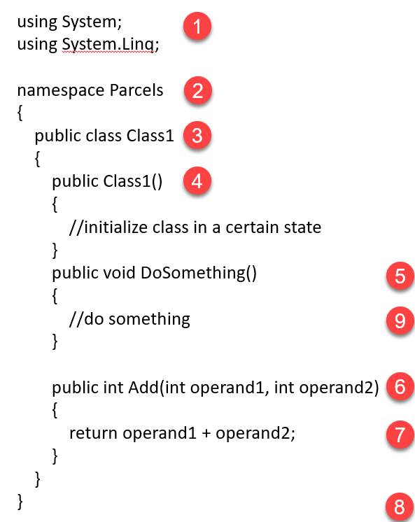
using as a declaration: like a shortcut to access anything in the System namespace including primitives such as string, int, double
Namespace: used to organize and separate code into “containers.” In C# the default is for code in a folder to use the name of the folder as the namespace.
Class: a blueprint of a specific object that carries data and/or functionality that object should have.
Constructor: a way to initialize an object to a certain state, usually by passing in objects or data to the parameters (if present).
Method (void): method that does something but returns void (i.e. does not return a value).
Method (int): method that returns an int value. Here, two int requirements must be passed into the method, which then adds them and returns the sum.
Statement: a line of code that performs some operation. Statements in C# are terminated by ;
Brackets: curly brackets designate start and end of code blocks, such as namespace, class, and methods. Are also used within methods for some statements such as if/else, for, foreach, and switch.
Comments: // are used to designate a comment

